Slide 1
SIHMON
Smart Infant Health Monitor
Naman Pal Eshan Salwan Satinder Kaur Zoyeba Mahbub

Slide 2
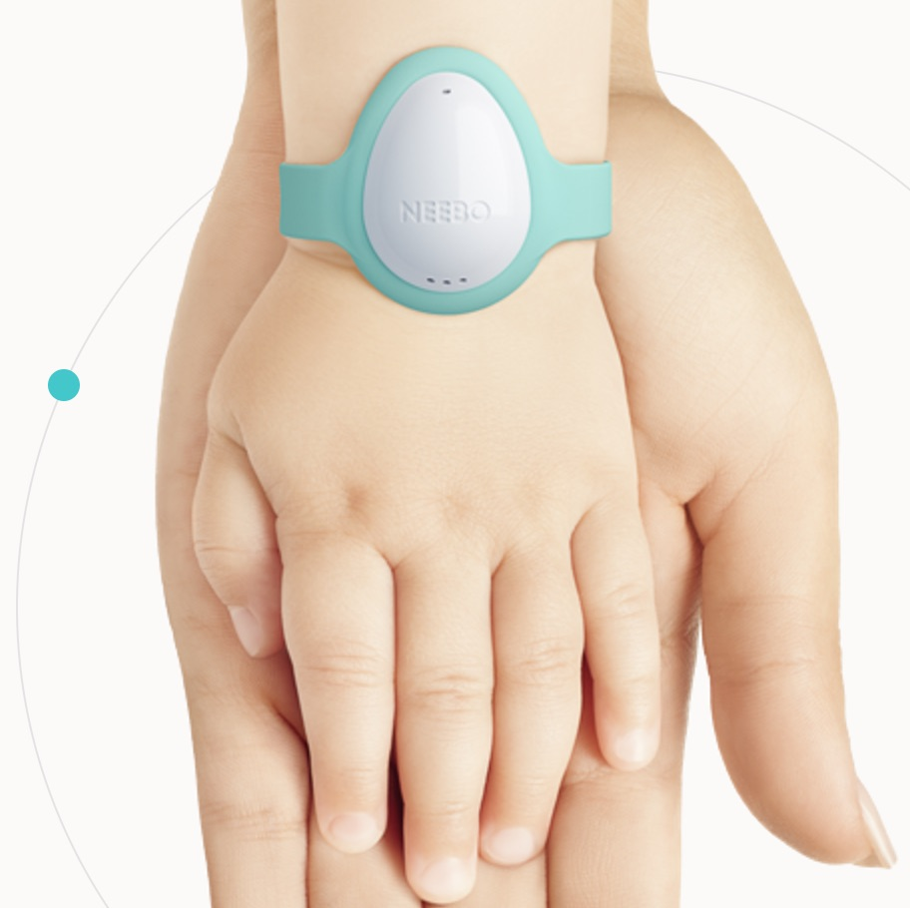
Agenda
Introduction
Hardware Components
Software Development
Integration
Testing
Conclusion

Slide 3
INTRODUCTION

Slide 4
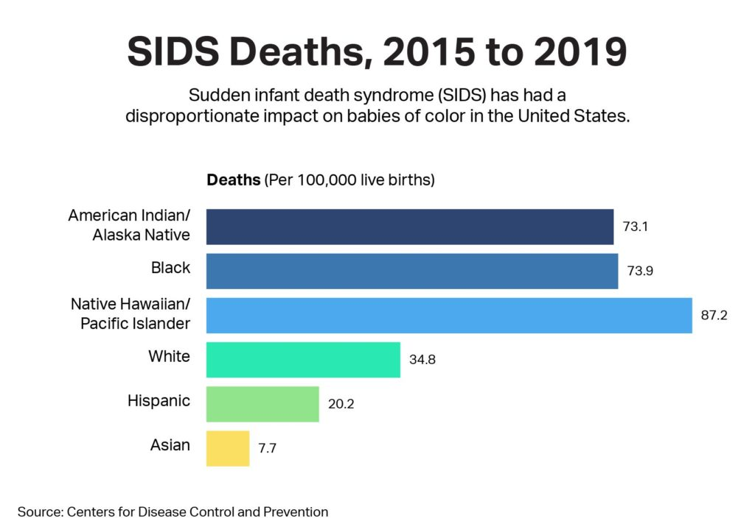
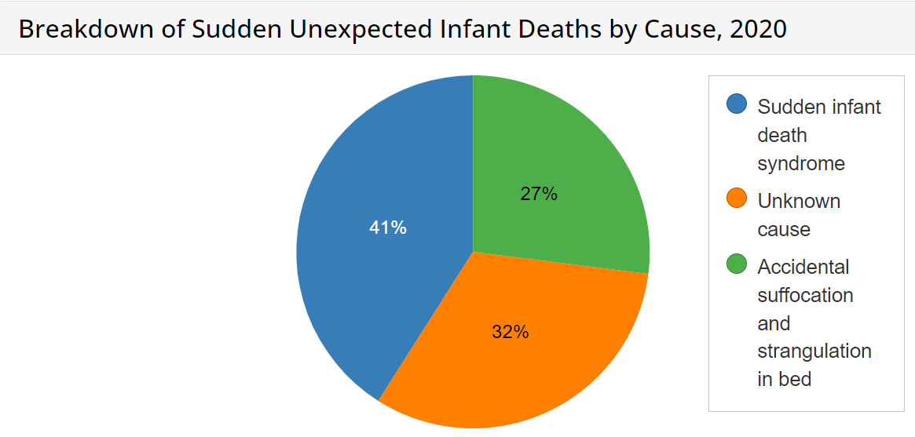
Problem Domain
SIDS causes 2500 infant deaths per year (US).
Gastrointestinal issues: leading cause of deaths of kids 5 and under (US).
Respiratory infections: cause 5/1000 live births (US).
1 million deaths due to parents being unaware of prematurely born babies health (WHO).

Slide 5

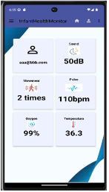




Solution
SMART INFANT HEALTH MONITOR
Advanced Health Monitoring
Real-Time Alerts
Data-Driven Insights: based on data.
Empowering Caregivers.

Slide 6
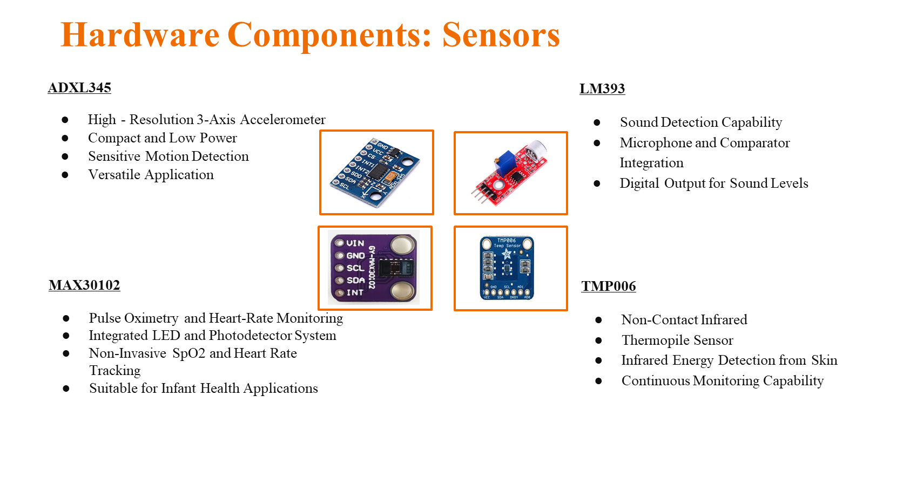

Slide 7
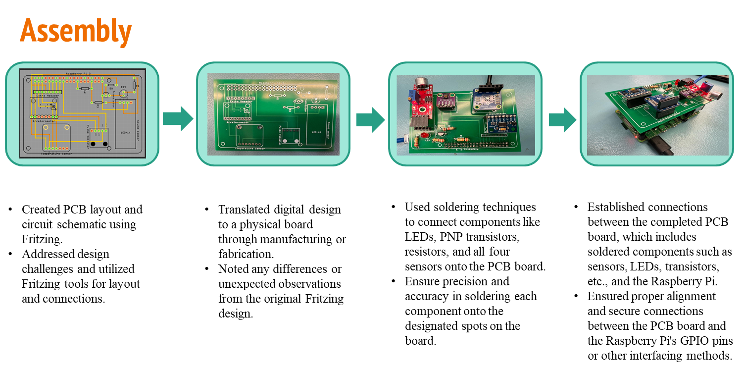

Slide 8

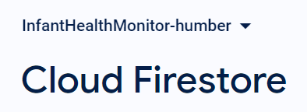
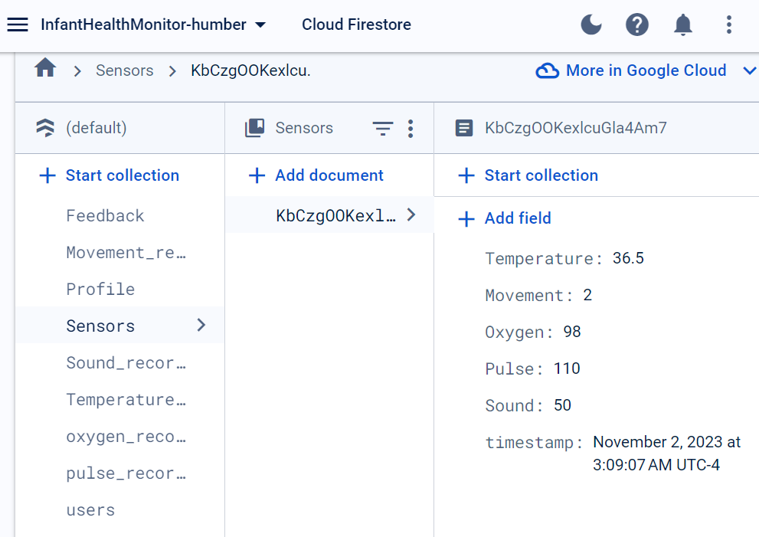
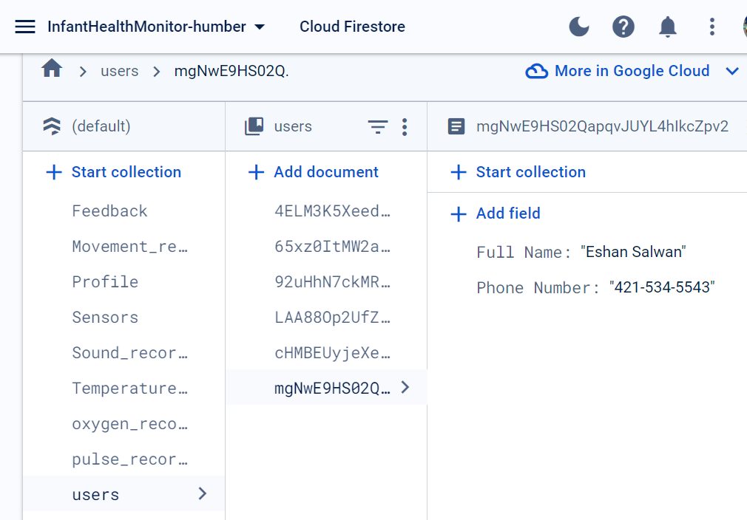
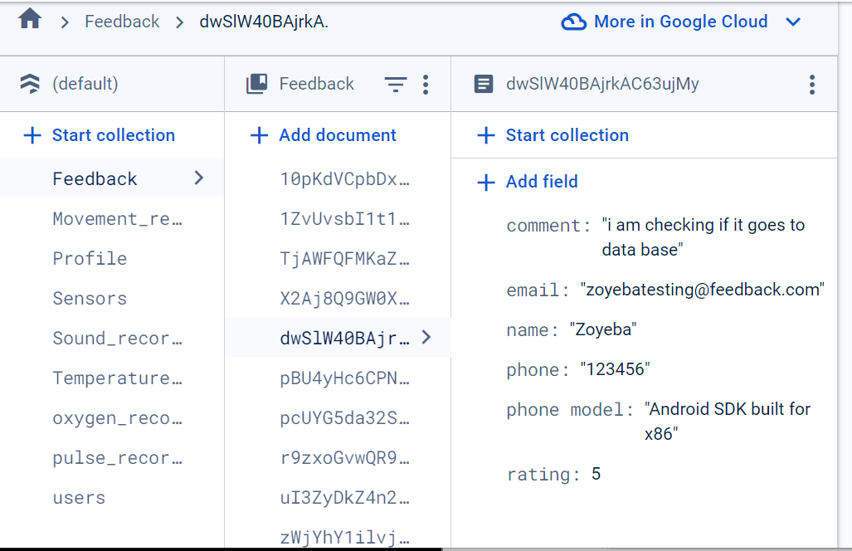
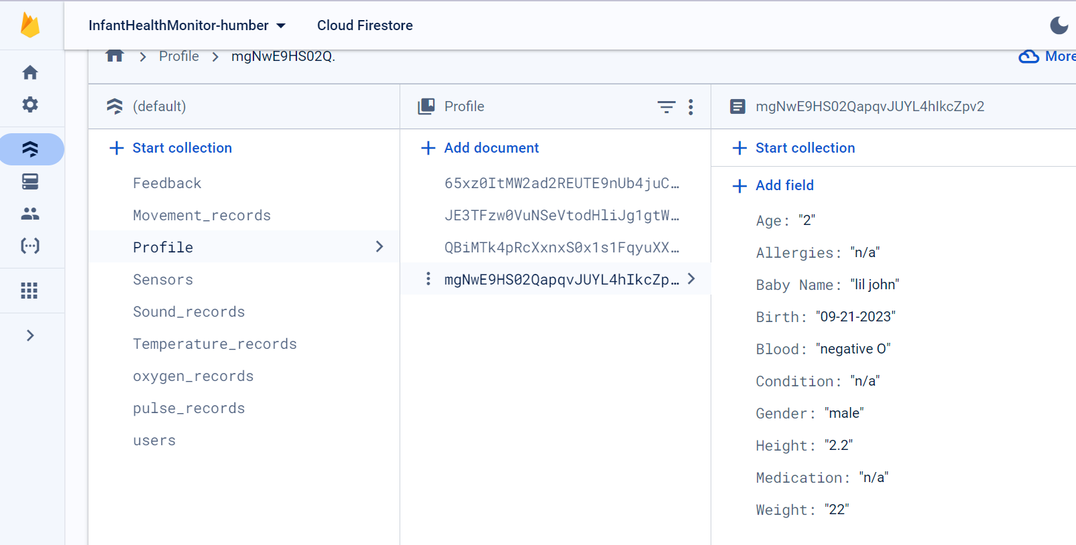
Firebase
Real time readings from all the sensors
User information and authentication
Feedback from the app
Profile data for the user

Slide 9
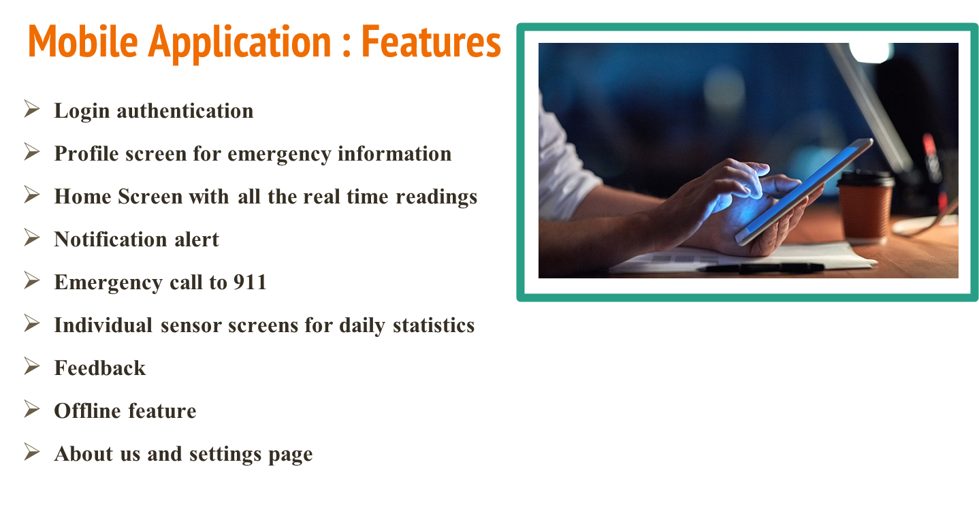

Slide 10
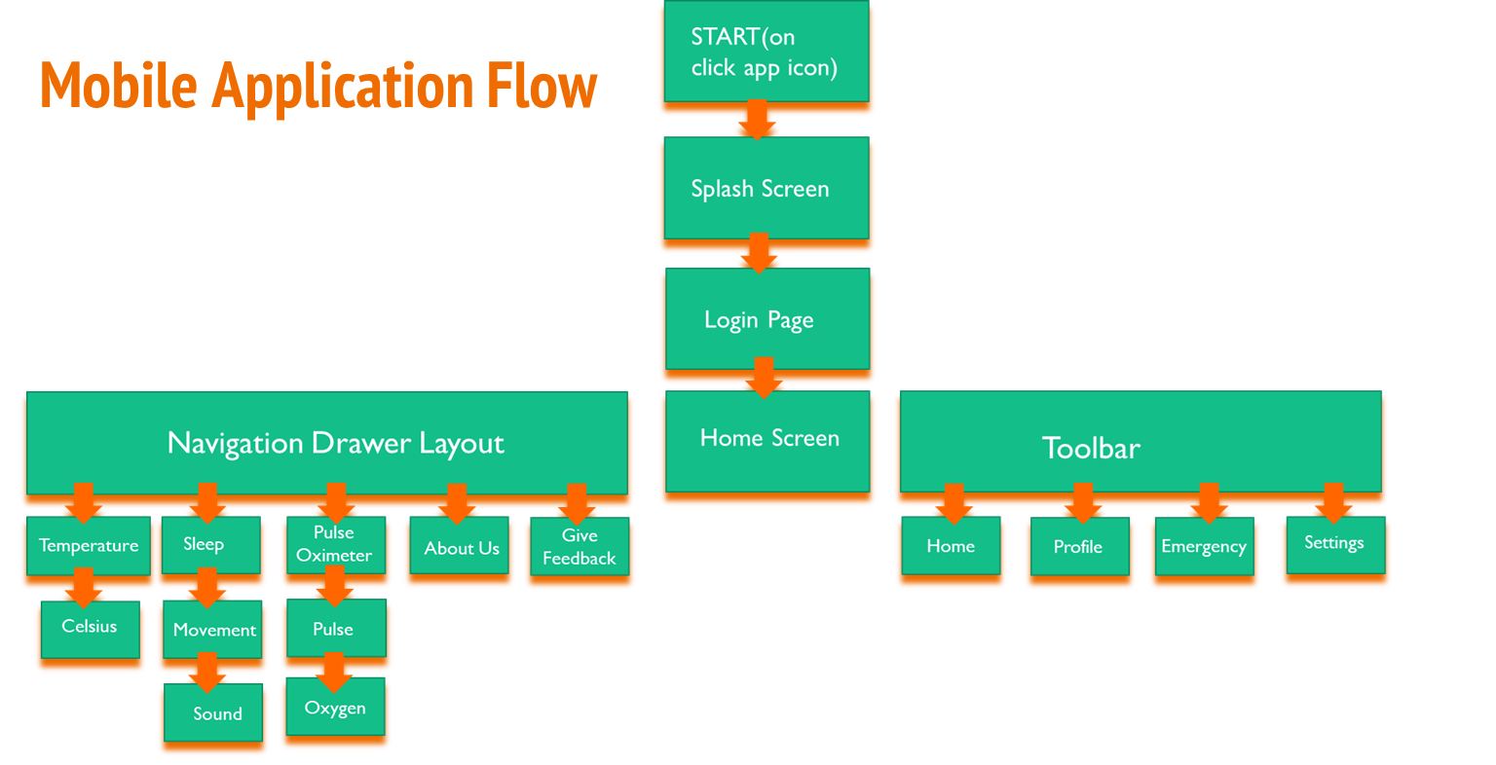

Slide 11
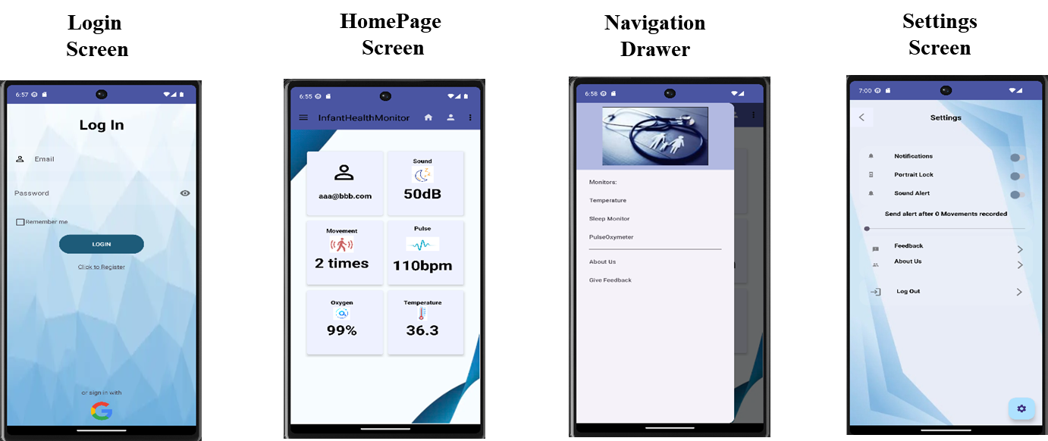
Screen Flow

Slide 12
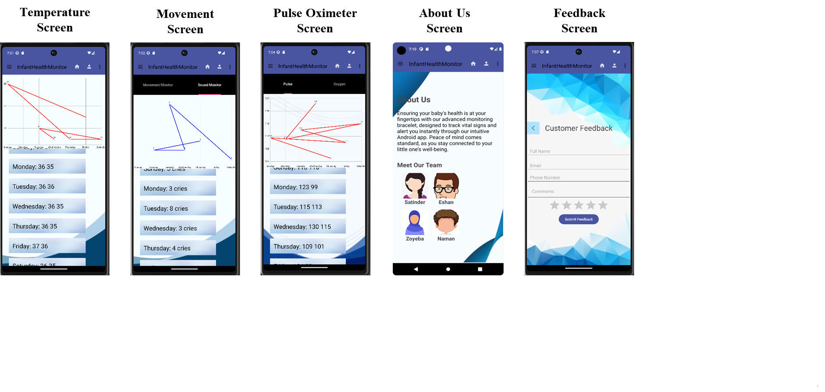
Screen Flow

Slide 13
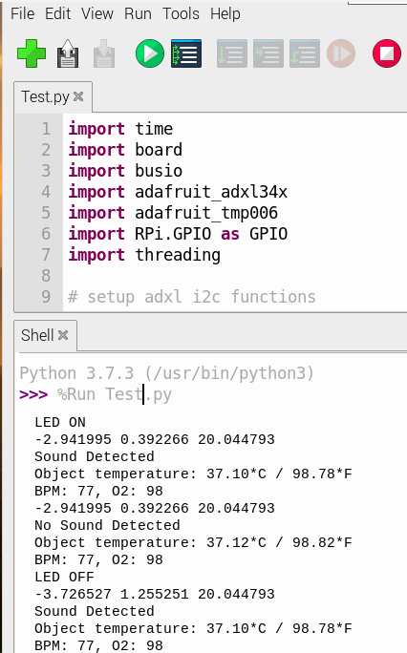
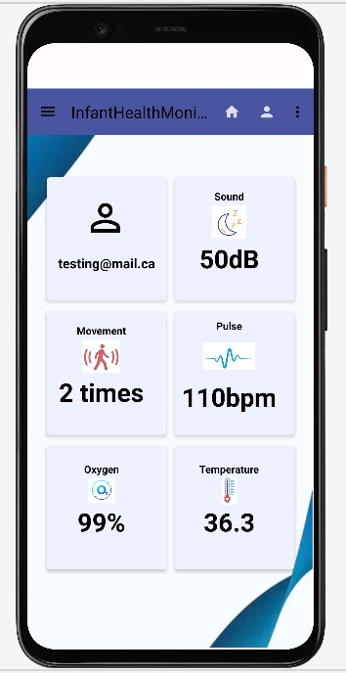
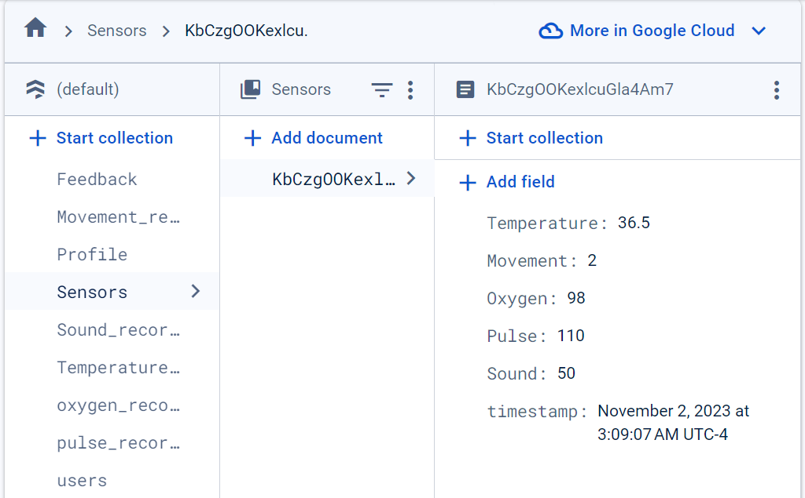
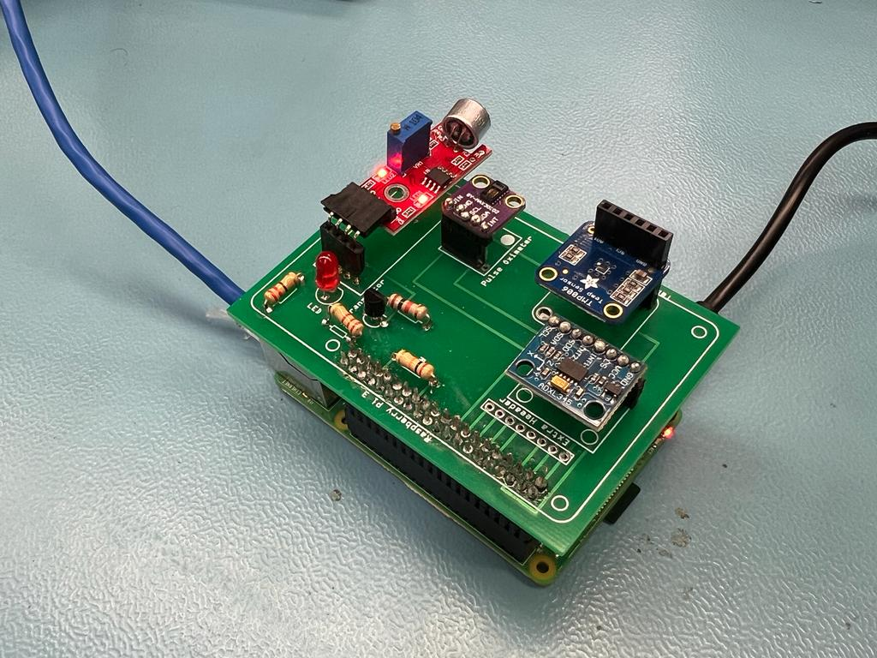
Testing and results
Assembly with Raspberry Pi, PCB, and sensors, data is visible on Firebase.
Data and graphs updated on the app.
App analyzes data and shows insights.

Slide 14



Conclusion
Advancing Infant Care: Our system is a leap forward in safeguarding infant health through advanced, non-invasive monitoring.
Empowering Caregivers: We provide caregivers with the tools for peace of mind and the ability to respond swiftly to the infants' needs.
Commitment to Innovation: We are dedicated to continuous improvement and innovation in the field of infant health technology.
Join us to be part of this vital change, whether through support, adoption, or spreading the word.

Slide 15



Thank you !!!
For exploring our vision for a future where every infant is monitored ensuring proper care and a healthier society. Together, we can make this vision a reality.

